Slide 1
Lecture 7

Slide 2
Example

Slide 3
Amplitude

Slide 4
Effect of φ
Same example, but with different values of φ

Slide 5
Anti-Nodes
Nodes

Slide 7
L

Slide 8
Question 223.6.6 Question 123.23.9
The nodes of a standing wave occur at
And the antinodes occur at
Can’t tell

Slide 9
Question 223.6.7 Question 123.23.10
I have my trusty ukulele and I have a string experiencing a standing wave. Which frequency corresponds to this wave shown?
The fundamental
The second harmonic
The third harmonic
The fourth harmonic

Slide 10
Question 18.2
Two identical waves travel in opposite directions in a medium. If each wave has amplitude, A, the maximum amplitude of the resultant wave would be
A
2A
4A
A/2

Slide 11
Question 18.3
Does the node of a standing wave move in the x direction?
Yes
No

Slide 12
Question 18.4
The nodes of a standing wave occur at
And the antinodes occur at
Can’t tell

Slide 13

Question 18.5
A string is clamped at both ends and plucked so it vibrates in a standing mode between two extreme positions a and b. Let upward motion correspond to positive velocities. When the string is in position c, the instantaneous velocity of points along the string:
1 is zero everywhere.
2 is positive everywhere.
3 is negative everywhere.
4 depends on location.
a
c
b

Slide 14

Answer
D).
P
R
Q

Slide 15
Question 18.6
A string is clamped at both ends and plucked so it vibrates in a standing mode between two extreme positions a and b. Let upward motion correspond to positive velocities. When the string is in position b, the instantaneous velocity of points along the string
is zero everywhere.
is positive everywhere.
is negative everywhere.
depends on location
a
c
b

Slide 16

Answer
A)
R
Q
P

Slide 17
Summary
Superposition
Standing Waves

Slide 18
Summary
Standing Waves in Strings

Slide 19
Question 123.21.6
Does a wave on a string move faster for a heavier or lighter rope?
yes
no

Slide 21
Before
9
After
9

Slide 23
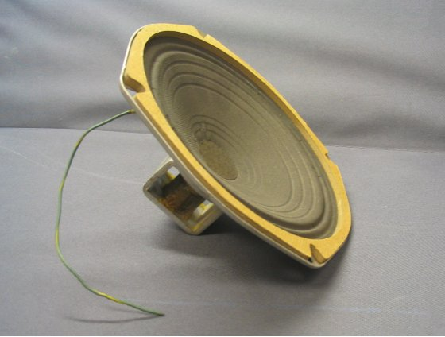

Slide 25
Question 7.5
For sound waves in air, something experiences simple harmonic motion, what is it?
A pipe
The air particles
The pressure
dust

Slide 26
Bar Graph of Displacement from Original Position

Slide 30
Question 223.2.8.1
S
x
In the displacement graph for a sound wave shown above. What does the light green bar represent?
The particle that was at this position has moved to the left
The particle that was at this position has moved to the right
The particle that was once where the pink bar is has moved to where the light green bar is
The particle that was once where the blue bar is has moved to where the light green bar is

Slide 31
Question 223.2.8.2
S
x₁
x_{P}
x₂
x
P
In the displacement graph for a sound wave shown above. What does the displacement, s, at point P represent?
The particle that was at x_{P} has moved to the left
The particle that was at x_{P} has moved to the right
The particle that was once at x₁ has moved to x_{P}
The particle that was once at x₂ has moved to x_{P}

Slide 32
Question 233.2.8.5
What is the energy transfer mechanism for sound waves?
Elastic forces between molecules
Pressure forces between molecules
Electrical forces between molecules
Collisions between molecules

Slide 33
Wave Function
Propagating rarefaction
s
Fluid displaced to fill void
s_{max}
x

Slide 34
Displacement
x
Change in Pressure
x

Slide 35
END

Slide 36
Question 123.21.7
A wave is traveling on a rope. Does the wave speed increase or decrease as you pull harder on a rope
Increase
Decrease

Slide 37
Question 16.9
A wave travels across a boundary between two different weight ropes. If it goes from the heavier to the lighter rope, the wave speed
Increases
Decreases
Stays the same
Can’t tell

Slide 38
Question 16.10
A wave travels across a boundary between two different weight ropes. If it goes from the lighter to the heavier rope, the reflected wave
Is inverted
Is not inverted
Can’t tell

Slide 39
Question 16.11
If one end of the rope is fixed to a pole, the reflected wave is inverted because
The rope dissipates energy so the pulse must be lower to account for the lower potential energy
The pole exerts an equal but opposite force on the end of the rope, so it is forced downward
The pull of gravity increases for the end of ropes
Can’t tell

Slide 40
Question 123.21.8
The speed of sound in water is about 1.4km/s. Will the speed of sound be faster or slower in air?
Faster
Slower
Can’t tell

Slide 41
Case One: Fixed End
There is a big change in the medium at the end of the rope.
The rope ends.
There is a person or (as in the figure) some thing holding the rope in place.
This change in medium causes a reflection.
In the fixed end case, the pulse is inverted.
Why?

Slide 42
0s
4s
1s
5s
2s
6s
3s
7s

Slide 43
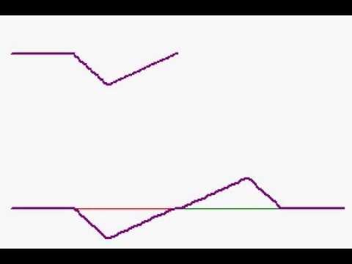

Slide 44
Forces on the End of the Rope
T_{y}
T_{y}
T
T_{y}
T_{x}
F_{g}
T_{x}
F_{wall}
F_{g}
T
F_{wall}

Slide 45
Reasonable?
Remember back in PH 121 (or statics) the book on the table?
Book has a force due to gravity
Table exerts a force equal to m_{book}g on the book

Slide 46
Demo
See if you can feel that you must provide the force

Slide 47
0s
4s
1s
5s
2s
6s
3s
7s

Slide 48
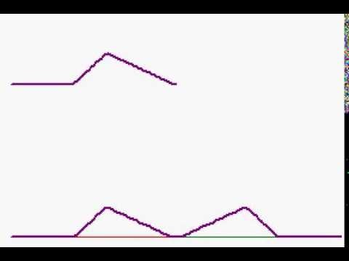

Slide 49
Forces on the End of the Rope
T_{y}
T_{y}
T
T_{y}
T_{x}
F_{g}
T_{x}
F_{g}
T

Slide 50
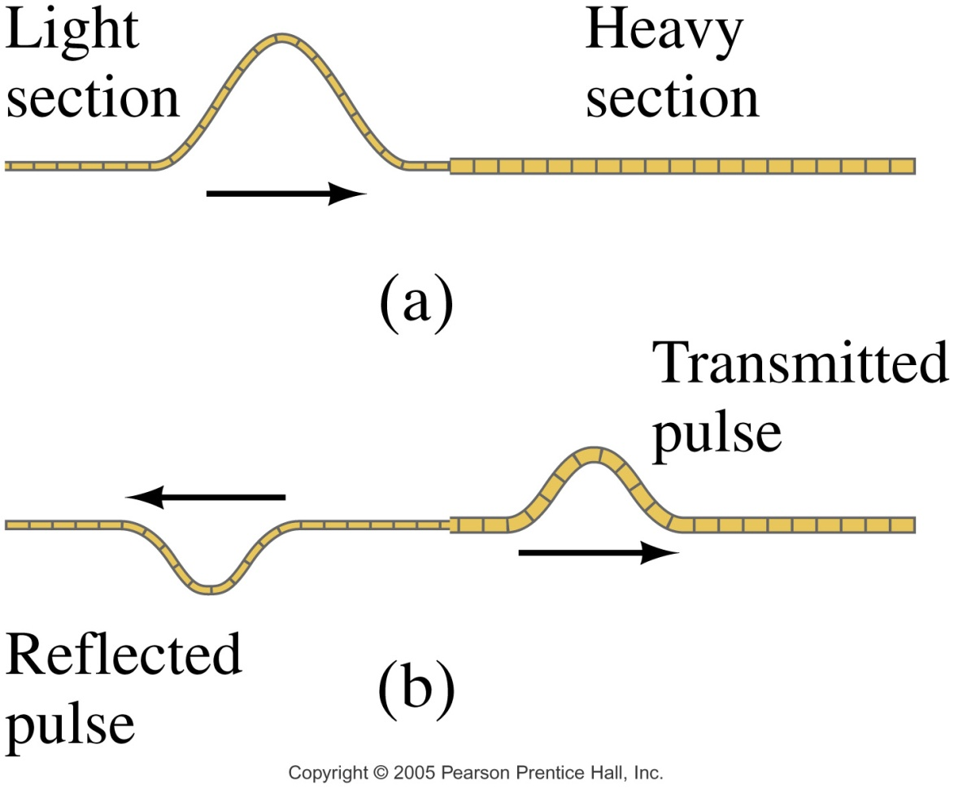
Case 3: Semi-loose End
Now the pulse is partially reflected
RHS rope sees a semi-fixed end point
LHS receives part of the pulse energy
New pulse has been “transmitted”

Slide 51
Forces on the End of the Rope
T_{y}
T_{y}
T
T_{y}
T_{x}
F_{g}
T_{x}
F_{RHS}
F_{g}
F_{RHSl}
T

Slide 52
Consider momentum
When we move from a less dense medium to a more dense medium
Reflected pulse is inverted
Pulse slows down
Which piece is harder to move?

Slide 53
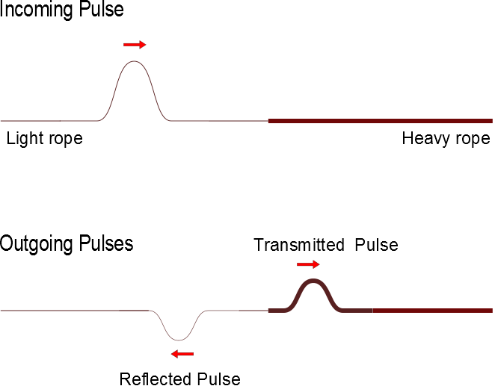
Superposition With and Inverted Pulse

